Slide 1
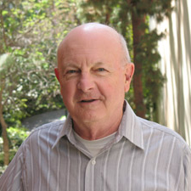
Convection and Waves in the Atmospheres of Venus and Jupiter
Significant Contributions by Jerry Schubert
Credit: UCLA
Dr. David Baker
Austin College
SchubFest May 8, 2026

Slide 2
Scientific Pillars Of Jerry
Explain
Observations
Apply Basic
Physical Principles
Collaborate With
Great People

Slide 3
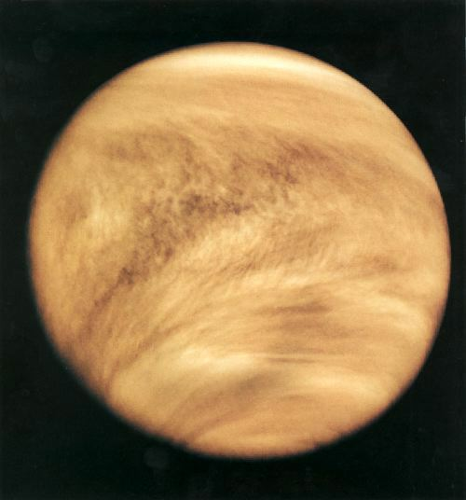
Venus Superrotation:
The Moving Flame
Schubert and Whitehead (1969)
Schubert and Young (1970)
Schubert et al. (1980)
Schubert (1983)
Waltersheid et al. (1985)
Covey et al. (1986)
Hollingsworth et al. (2007)
Lebonnois et al. (2012)
Credit: NASA, Pioneer Venus

Slide 4
Venus Convection
Covey and Schubert (1981)
Credit: NASA, Pioneer Venus
Notes:
Fukuhara, T., Futaguchi, M., Hashimoto, G. et al. Large stationary gravity wave in the atmosphere of Venus. Nature Geosci 10, 85–88 (2017). https://doi.org/10.1038/ngeo2873
Navarro, T., Schubert, G. & Lebonnois, S. Atmospheric mountain wave generation on Venus and its influence on the solid planet’s rotation rate. Nature Geosci 11, 487–491 (2018). https://doi.org/10.1038/s41561-018-0157-x

Slide 5
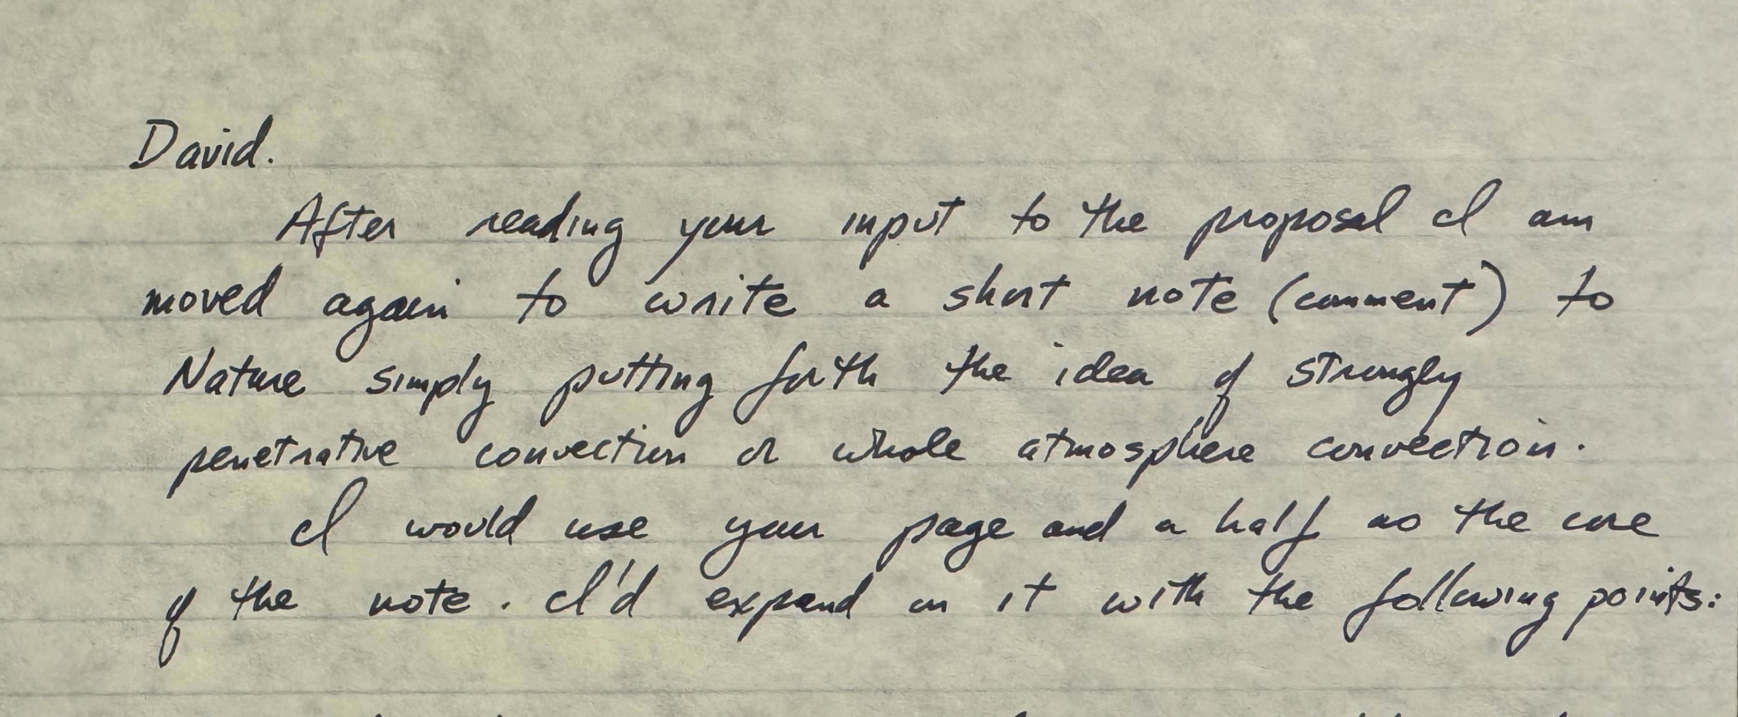
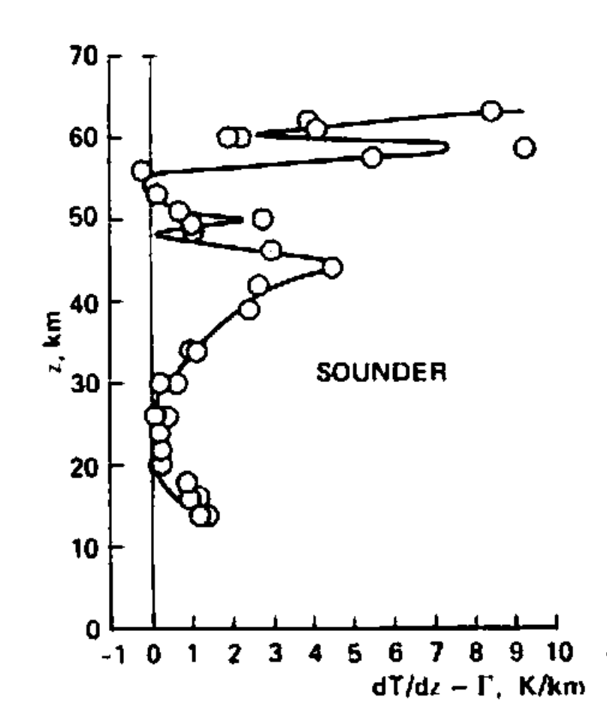
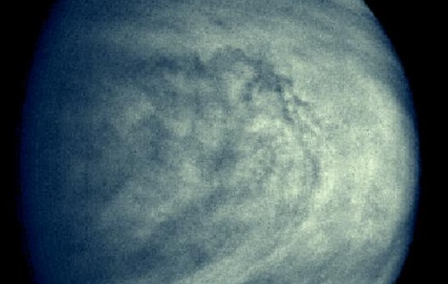
Venus Convection
Covey and Schubert (1981)
Baker and Schubert (1992)
Baker et al. (1998, 1999)
Seiff et al. (1980)
Credit: NASA, Galileo
Notes:
Fukuhara, T., Futaguchi, M., Hashimoto, G. et al. Large stationary gravity wave in the atmosphere of Venus. Nature Geosci 10, 85–88 (2017). https://doi.org/10.1038/ngeo2873
Navarro, T., Schubert, G. & Lebonnois, S. Atmospheric mountain wave generation on Venus and its influence on the solid planet’s rotation rate. Nature Geosci 11, 487–491 (2018). https://doi.org/10.1038/s41561-018-0157-x

Slide 6
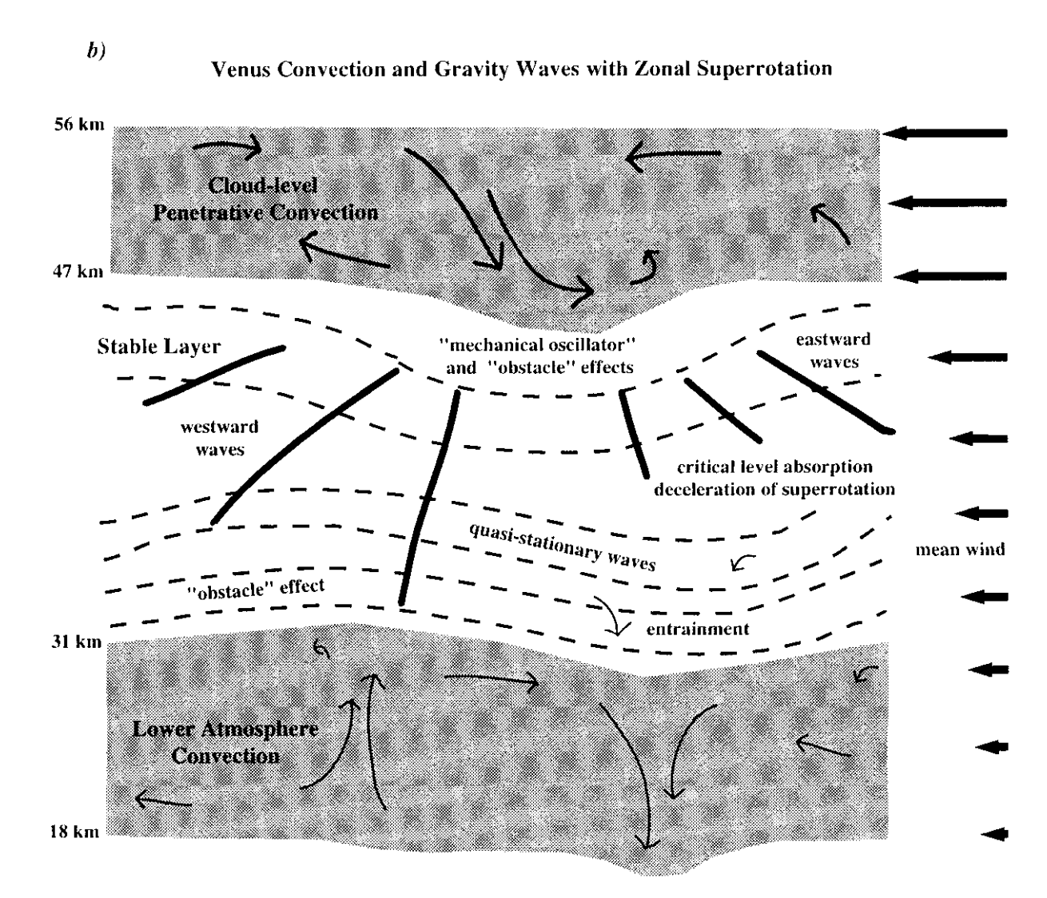
Venus Gravity Waves
Baker et al. (2000a, b)
Seiff et al. (1980)
Notes:
Fukuhara, T., Futaguchi, M., Hashimoto, G. et al. Large stationary gravity wave in the atmosphere of Venus. Nature Geosci 10, 85–88 (2017). https://doi.org/10.1038/ngeo2873
Navarro, T., Schubert, G. & Lebonnois, S. Atmospheric mountain wave generation on Venus and its influence on the solid planet’s rotation rate. Nature Geosci 11, 487–491 (2018). https://doi.org/10.1038/s41561-018-0157-x

Slide 7
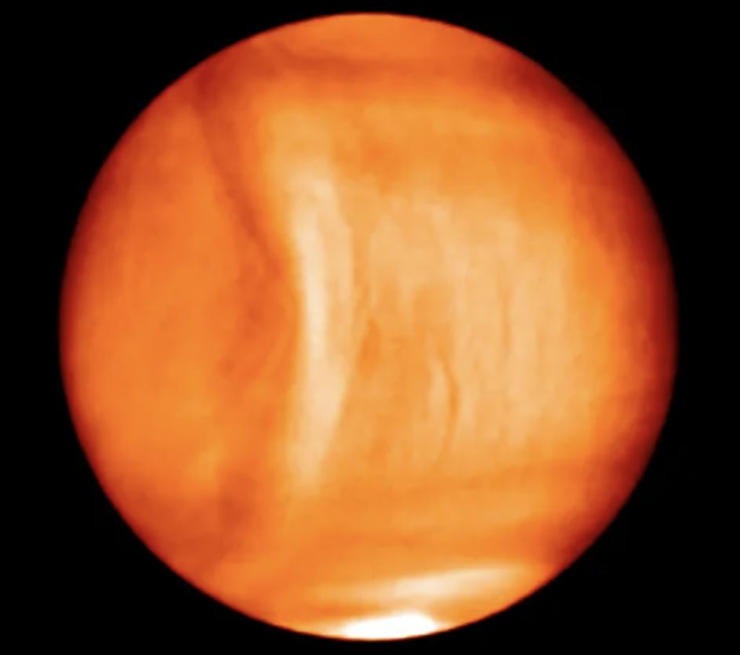
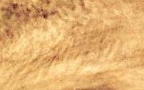

Venus Gravity Waves
Baker et al. (2000a, b)
Del Genio et al. (1979)
Schubert and Walterscheid (1984)
Young et al. (1987, 1994)
Navarro et al. (2018)
Credit: NASA, Pioneer Venus
Fukuhara et al. (2017)
Notes:
Fukuhara, T., Futaguchi, M., Hashimoto, G. et al. Large stationary gravity wave in the atmosphere of Venus. Nature Geosci 10, 85–88 (2017). https://doi.org/10.1038/ngeo2873
Navarro, T., Schubert, G. & Lebonnois, S. Atmospheric mountain wave generation on Venus and its influence on the solid planet’s rotation rate. Nature Geosci 11, 487–491 (2018). https://doi.org/10.1038/s41561-018-0157-x

Slide 8
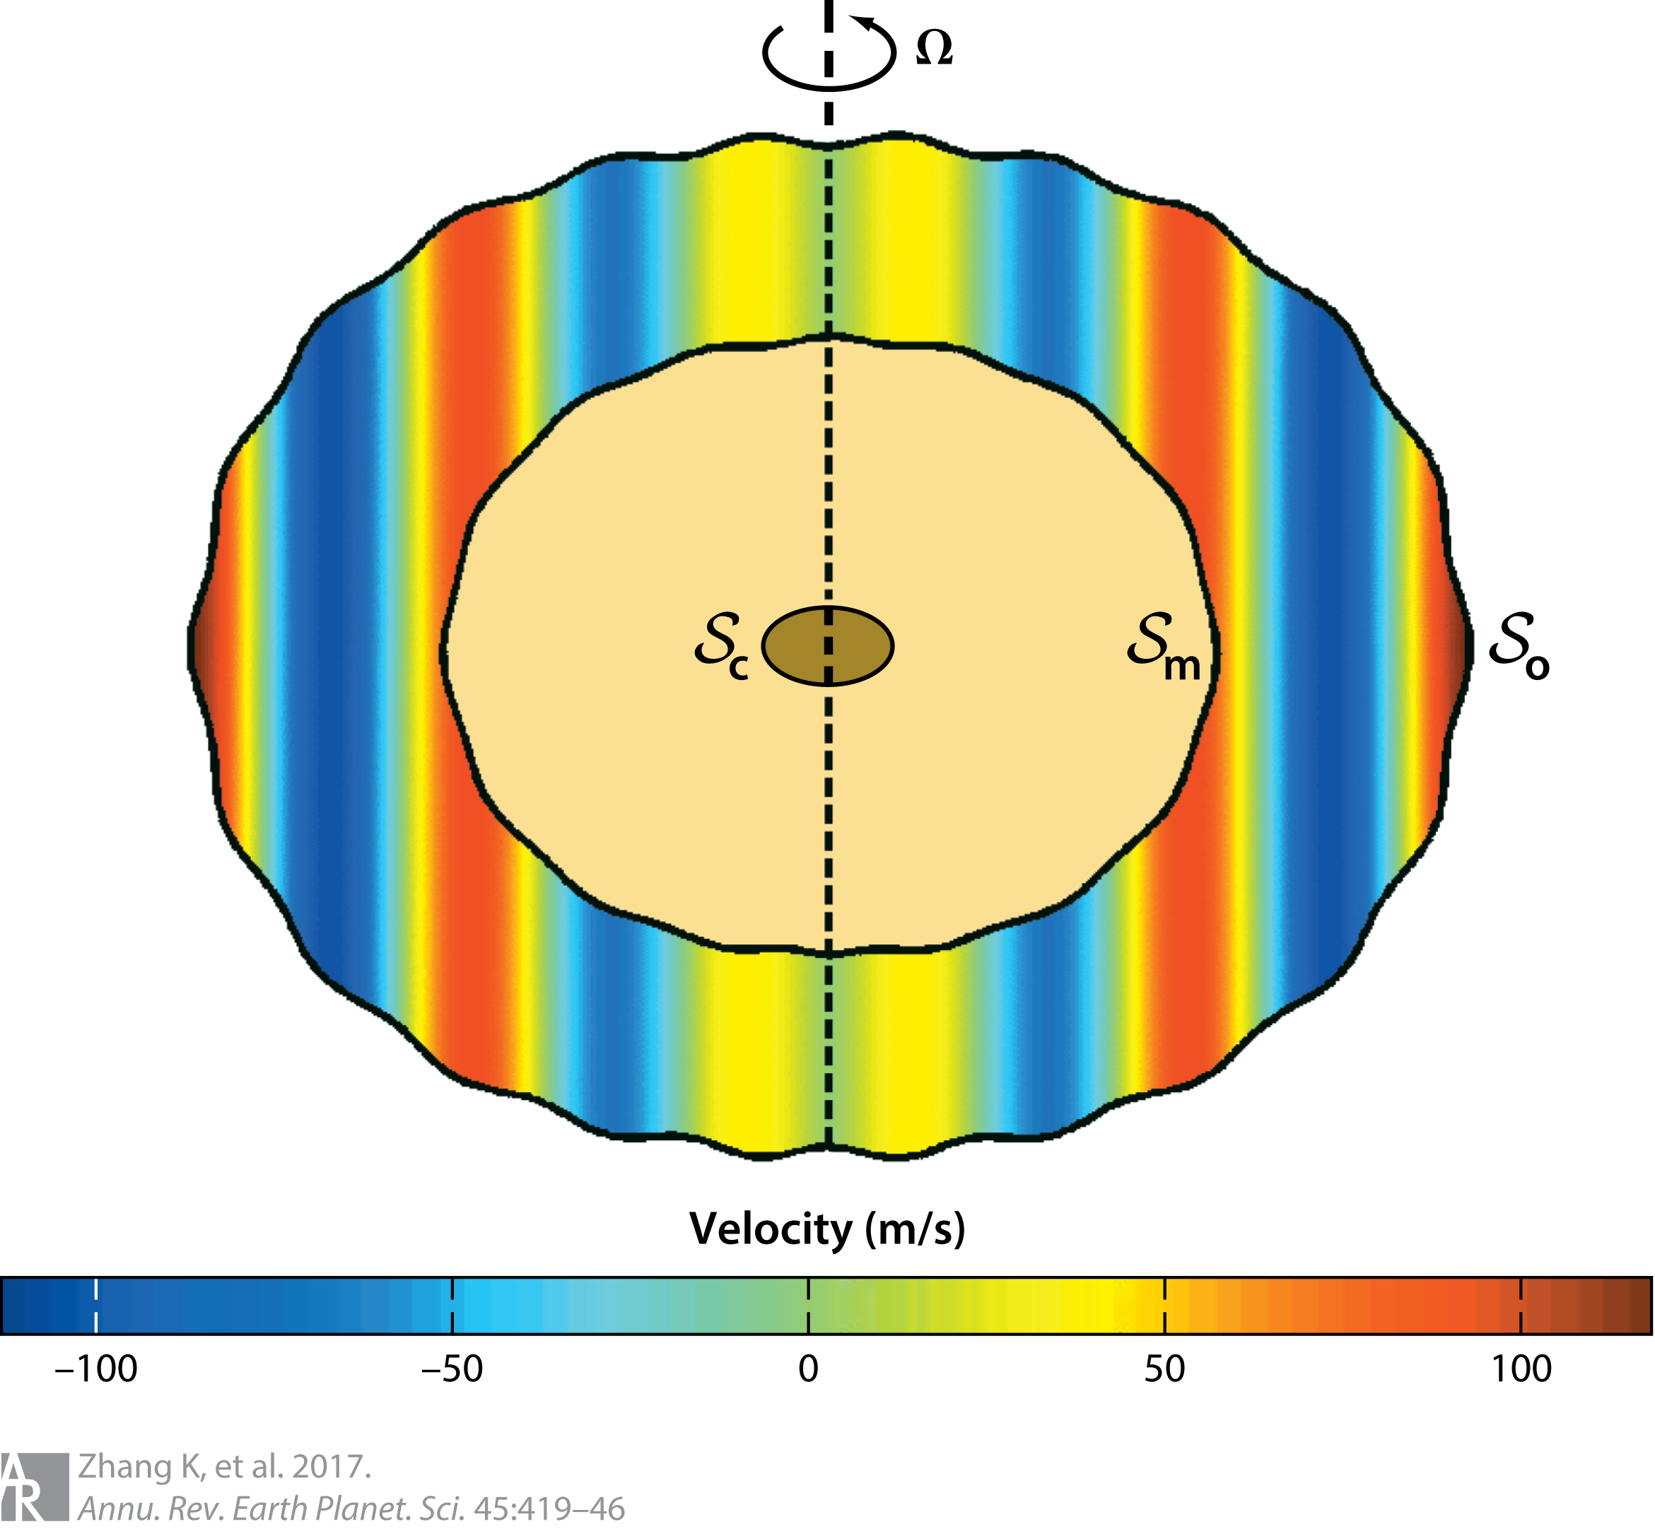
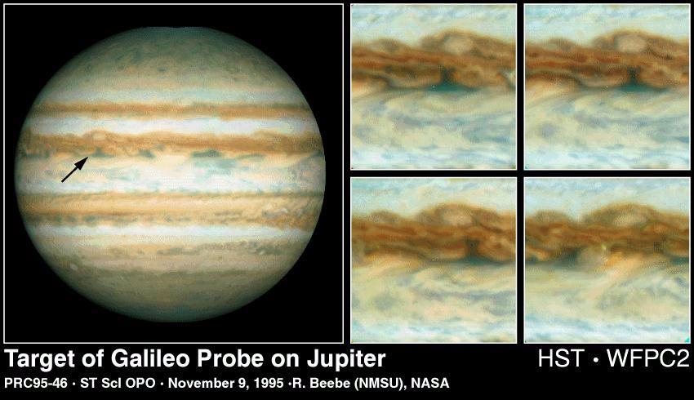
Jupiter Convection: Deep vs. Shallow
Seiff et al. (1996)
Baker and Schubert (1998)
Sun et al. (1993)
Zhang et al. (1996)
Zhang et al. (2017)
Kong et al. (2018)
Notes:
https://www.science.org/doi/abs/10.1126/science.273.5277.941
https://www.annualreviews.org/content/journals/10.1146/annurev-earth-063016-020305

Slide 9
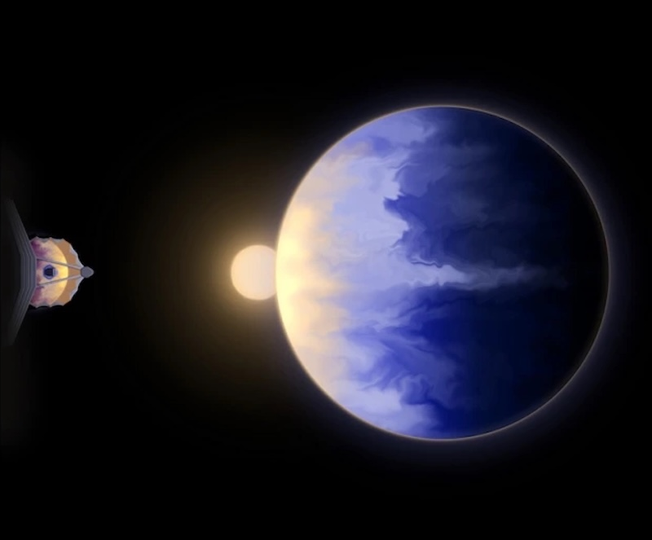
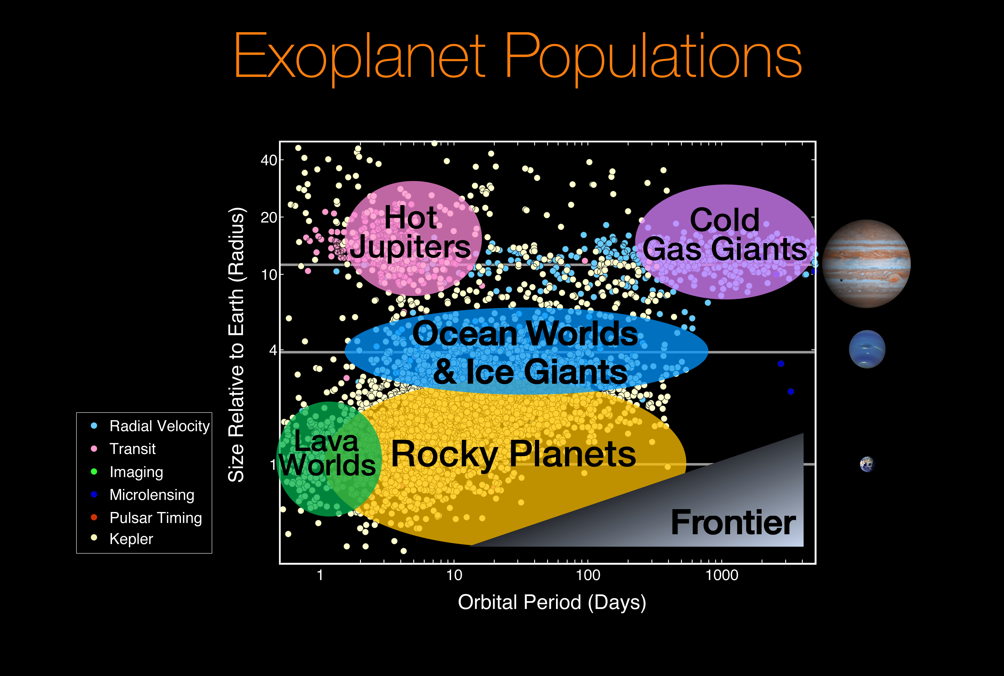
WWSD: What Would Schubert Do?
Credit: Rachel Amaro/University of Arizona
Credit: NASA/Ames Research Center/Natalie Batalha/Wendy Stenzel

Slide 10

Credit: Jerry Schubert

Slide 11
Baker II, R.D. and Schubert, G., 1992. Cellular convection in the atmosphere of Venus. Nature, 355(6362), pp.710-712.
Baker, R.D. and Schubert, G., 1998. Deep convective entrainment by downdrafts in Jupiter's atmosphere. Icarus, 136(2), pp.340-343.
Baker, R.D., Schubert, G. and Jones, P.W., 1998. Cloud-level penetrative compressible convection in the Venus atmosphere. Journal of the atmospheric sciences, 55(1), pp.3-18.
Baker, R.D., Schubert, G. and Jones, P.W., 1999. High Rayleigh number compressible convection in Venus' atmosphere: Penetration, entrainment, and turbulence. Journal of Geophysical Research: Planets, 104(E2), pp.3815-3832.
Baker, R.D., Schubert, G. and Jones, P.W., 2000. Convectively generated internal gravity waves in the lower atmosphere of Venus. Part I: No wind shear. Journal of the atmospheric sciences, 57(2), pp.184-199.
Baker, R.D., Schubert, G. and Jones, P.W., 2000. Convectively generated internal gravity waves in the lower atmosphere of Venus. Part II: Mean wind shear and wave–mean flow interaction. Journal of the atmospheric sciences, 57(2), pp.200-215.
Covey, C.C. and Schubert, G., 1981. Mesoscale convection in the clouds of Venus. Nature, 290(5801), pp.17-20.
Covey, C., Walterscheid, R.L. and Schubert, G., 1986. Dissipative tides: Application to Venus' lower atmosphere. Journal of Atmospheric Sciences, 43(24), pp.3273-3278.
Del Genio, A.D., Schubert, G. and Straus, J.M., 1979. Acoustic-gravity waves in the thermosphere of Venus. Icarus, 39(3), pp.401-417.
Fukuhara, T., Futaguchi, M., Hashimoto, G. et al. Large stationary gravity wave in the atmosphere of Venus. Nature Geosci 10, 85–88 (2017). https://doi.org/10.1038/ngeo2873
Hollingsworth, J.L., Young, R.E., Schubert, G., Covey, C. and Grossman, A.S., 2007. A simple‐physics global circulation model for Venus: Sensitivity assessments of atmospheric superrotation. Geophysical research letters, 34(5).
Lebonnois, S., Covey, C., Grossman, A., Parish, H., Schubert, G., Walterscheid, R., Lauritzen, P. and Jablonowski, C., 2012. Angular momentum budget in General Circulation Models of superrotating atmospheres: A critical diagnostic. Journal of Geophysical Research: Planets, 117(E12).
Navarro, T., Schubert, G. and Lebonnois, S., 2018. Atmospheric mountain wave generation on Venus and its influence on the solid planet’s rotation rate. Nature Geoscience, 11(7), pp.487-491.
Oberhaus, D., Prada, L., Boisvert, L., Stockton, N., Fong, G., & Catlin, C. (2018). The atmosphere of Venus is so thick it pushes on mountains to change how fast the planet spins. VICE. https://www.vice.com/en/article/venus-atmosphere-is-so-thick-it-moves-mountains/
Schubert, G. and Whitehead, J.A., 1969. Moving flame experiment with liquid mercury: Possible implications for the Venus atmosphere. Science, 163(3862), pp.71-72.
Schubert, G., and R. E. Young, 1970: The 4-Day Venus Circulation Driven by Periodic Thermal Forcing. J. Atmos. Sci., 27, 523–528, https://doi.org/10.1175/1520-0469(1970)027<0523:TDVCDB>2.0.CO;2.
Schubert, G., et al., 1980, Structure and circulation of the Venus atmosphere, J. Geophys. Res., 85(A13), 8007–8025, doi:10.1029/JA085iA13p08007.
Schubert, G.,1983, General circulation and the dynamical state of the Venus atmosphere. Venus 681–765., https://ui.adsabs.harvard.edu/abs/1983vens.book..681S
Schubert, G. and Walterscheid, R.L., 1984. Propagation of small-scale acoustic-gravity waves in the Venus atmosphere. Journal of Atmospheric Sciences, 41(7), pp.1202-1213.
Schubert, G. (2019). Reminiscences of my life in science. Research in Astronomy and Astrophysics, 19(4), 050. https://doi.org/10.1088/1674-4527/19/4/50
Seiff, A., Kirk, D.B., Young, R.E., Blanchard, R.C., Findlay, J.T., Kelly, G.M. and Sommer, S.C., 1980. Measurements of thermal structure and thermal contrasts in the atmosphere of Venus and related dynamical observations: Results from the four Pioneer Venus probes. Journal of Geophysical Research: Space Physics, 85(A13), pp.7903-7933.
Seiff, A., Kirk, D.B., Knight, T.C., Mihalov, J.D., Blanchard, R.C., Young, R.E., Schubert, G., Von Zahn, U., Lehmacher, G., Milos, F.S. and Wang, J., 1996. Structure of the atmosphere of Jupiter: Galileo probe measurements. Science, 272(5263), pp.844-845.
Sun, Z.P., Schubert, G. and Glatzmaier, G.A., 1993. Banded surface flow maintained by convection in a model of the rapidly rotating giant planets. Science, 260(5108), pp.661-664.
Walterscheid, R.L., Schubert, G., Newman, M. and Kliore, A.J., 1985. Zonal winds and the angular momentum balance of Venus’ atmosphere within and above the clouds. Journal of Atmospheric Sciences, 42(19), pp.1982-1990.
Young, R.E., Walterscheid, R.L., Schubert, G., Seiff, A., Linkin, V.M. and Lipatov, A.N., 1987. Characteristics of gravity waves generated by surface topography on Venus: Comparison with the VEGA balloon results. Journal of Atmospheric Sciences, 44(18), pp.2628-2639.
Young, R.E., Walterscheid, R.L., Schubert, G., Pfister, L., Houben, H. and Bindschadler, D.L., 1994. Characteristics of finite amplitude stationary gravity waves in the atmosphere of Venus. Journal of Atmospheric Sciences, 51(13), pp.1857-1875.
Zhang, K. and Schubert, G., 1996. Penetrative convection and zonal flow on Jupiter. Science, 273(5277), pp.941-943.
Zhang, K., Kong, D. and Schubert, G., 2017. Shape, internal structure, zonal winds, and gravitational field of rapidly rotating Jupiter-like planets. Annual Review of Earth and Planetary Sciences, 45, pp.419-446.

