Slide 1
Jerry Schubert Fest
Dr. Martin Ross Class of 1988
The Aerospace Corporation
May 08 2026

Slide 2
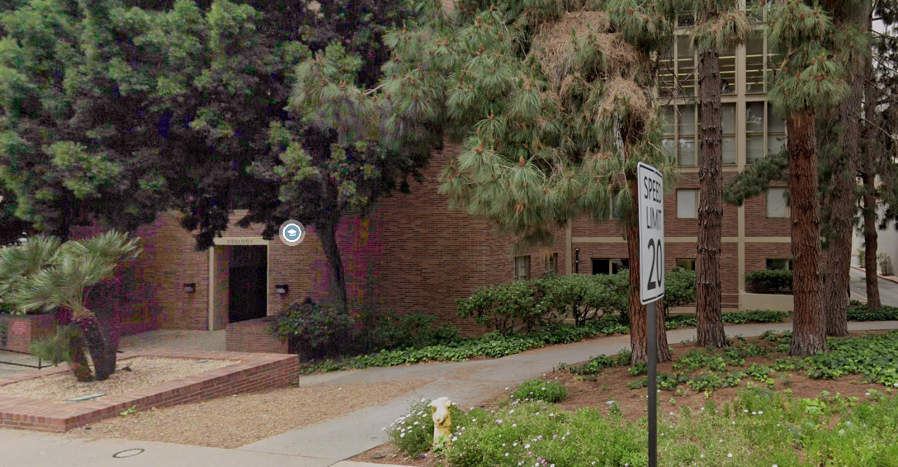
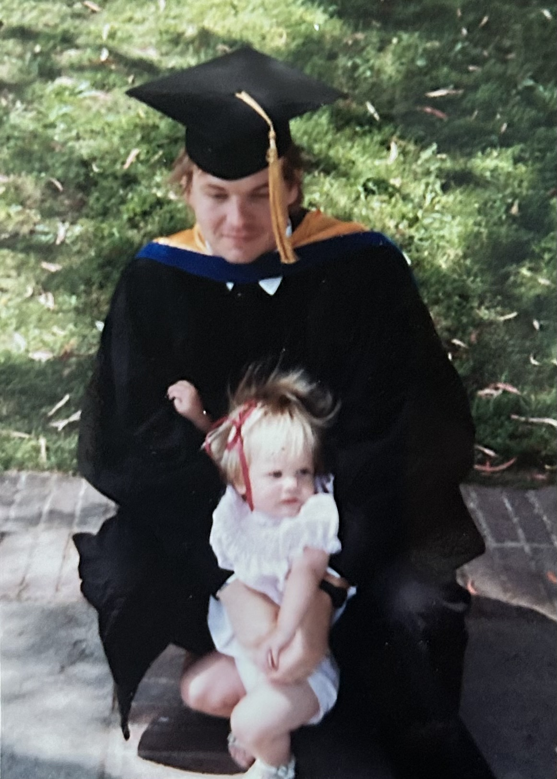
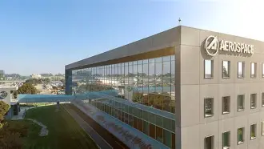
Me
UM Aerospace Engineering 1981
Met Jerry at 1981 AGU meeting
Graduate student 1982 – 1988
The Aerospace Corporation since 1988
Continued to work with Jerry into 1990s

Slide 3
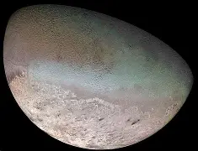
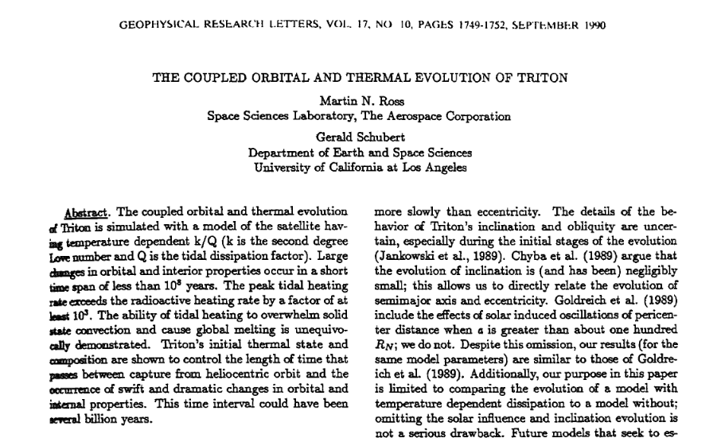
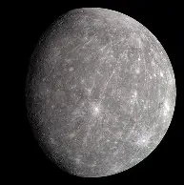
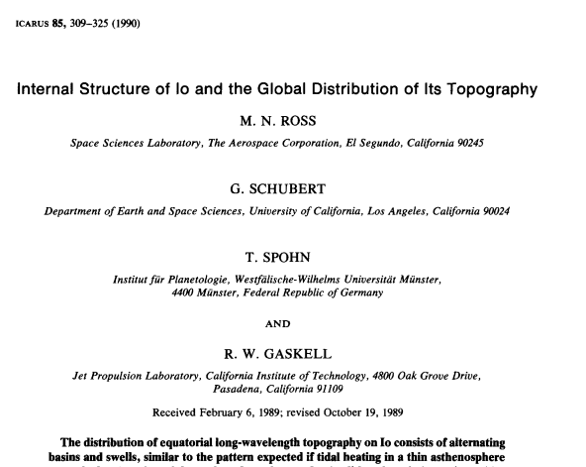
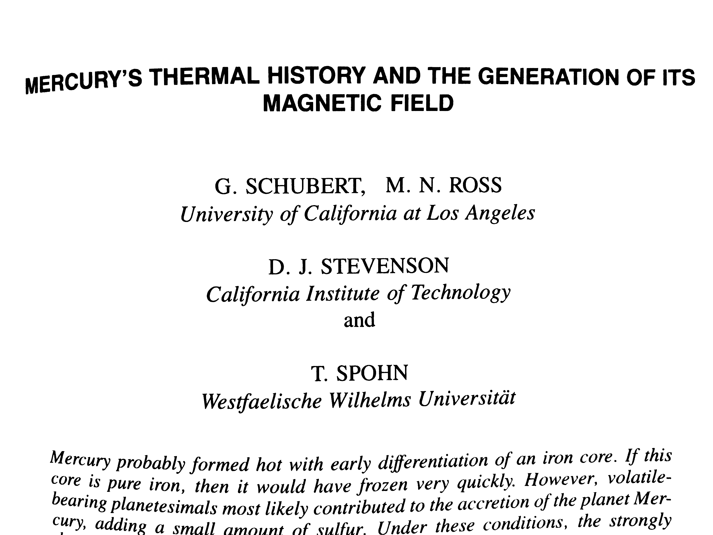
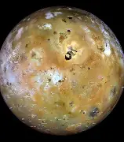
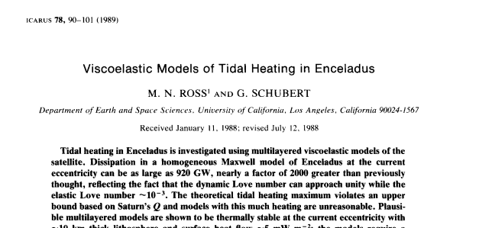
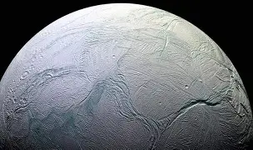
Grad School Years
Internal Structure and Orbital Evolution of Planets and Satellites
Tidal dissipation + thermal and dynamical evolution
GRL and Icarus
Enceladus paper second most referenced
Always encouraged to work out ideas no matter how crazy
Jerry was always out front in the Golden Age of Solar System exploration

Slide 4

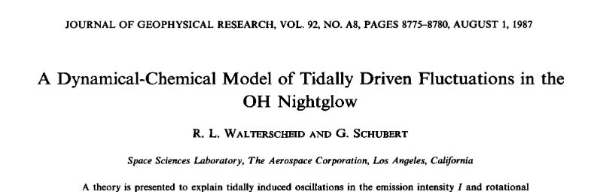
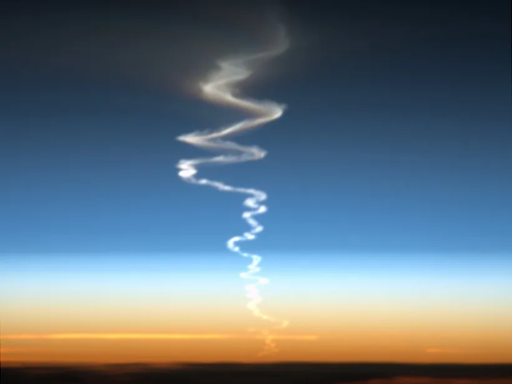
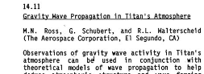
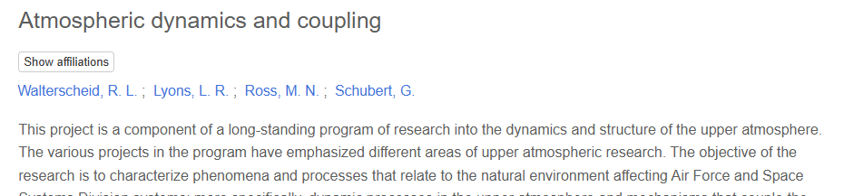
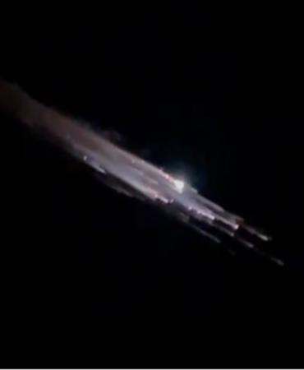
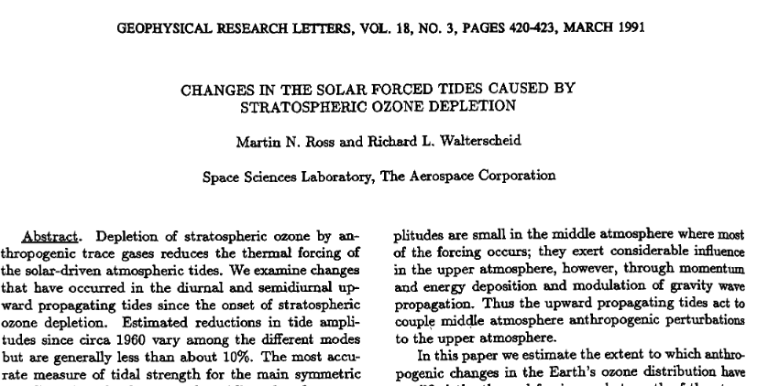
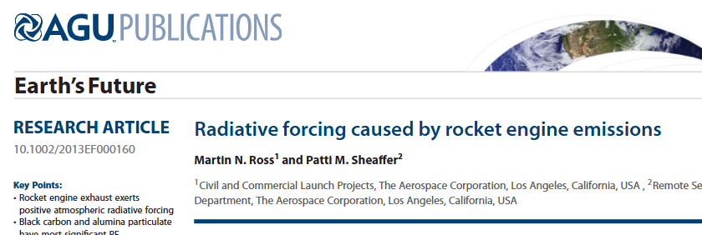
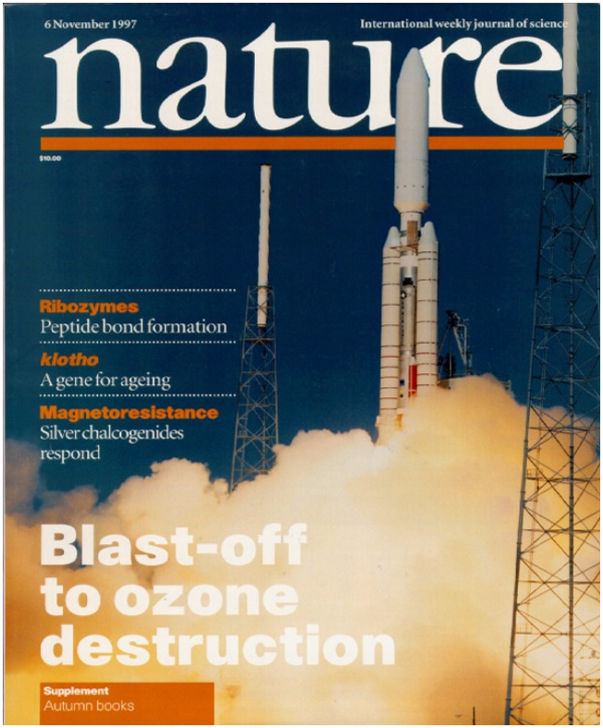
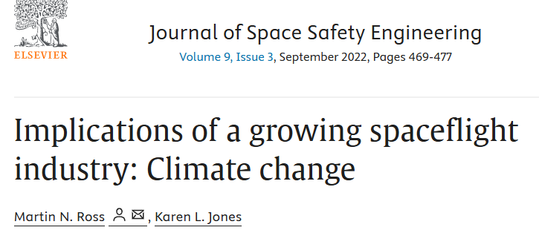
Connection
Jerry consulted at Aerospace and brought me in
Amazing place: Aerospace was like Bell Labs until the mid-1990s
Jerry helped me move into atmosphere work
Mentor: Richard Walterscheid
Jerry and Richard were very productive at Aerospace
Claim to Fame: invented the idea that gas and aerosol emissions from rockets and reentries could affect climate and stratospheric ozone

Slide 5
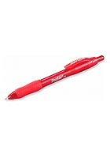
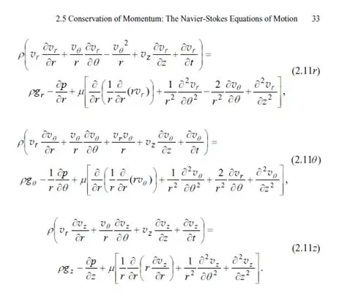
What I learned From Jerry
The dreaded Red Pen
How to write
Take the 50 km view
Uncertain? Parametrize
Do not get overly detailed
Collaborate
Boundary conditions
Give credit generously

Slide 6
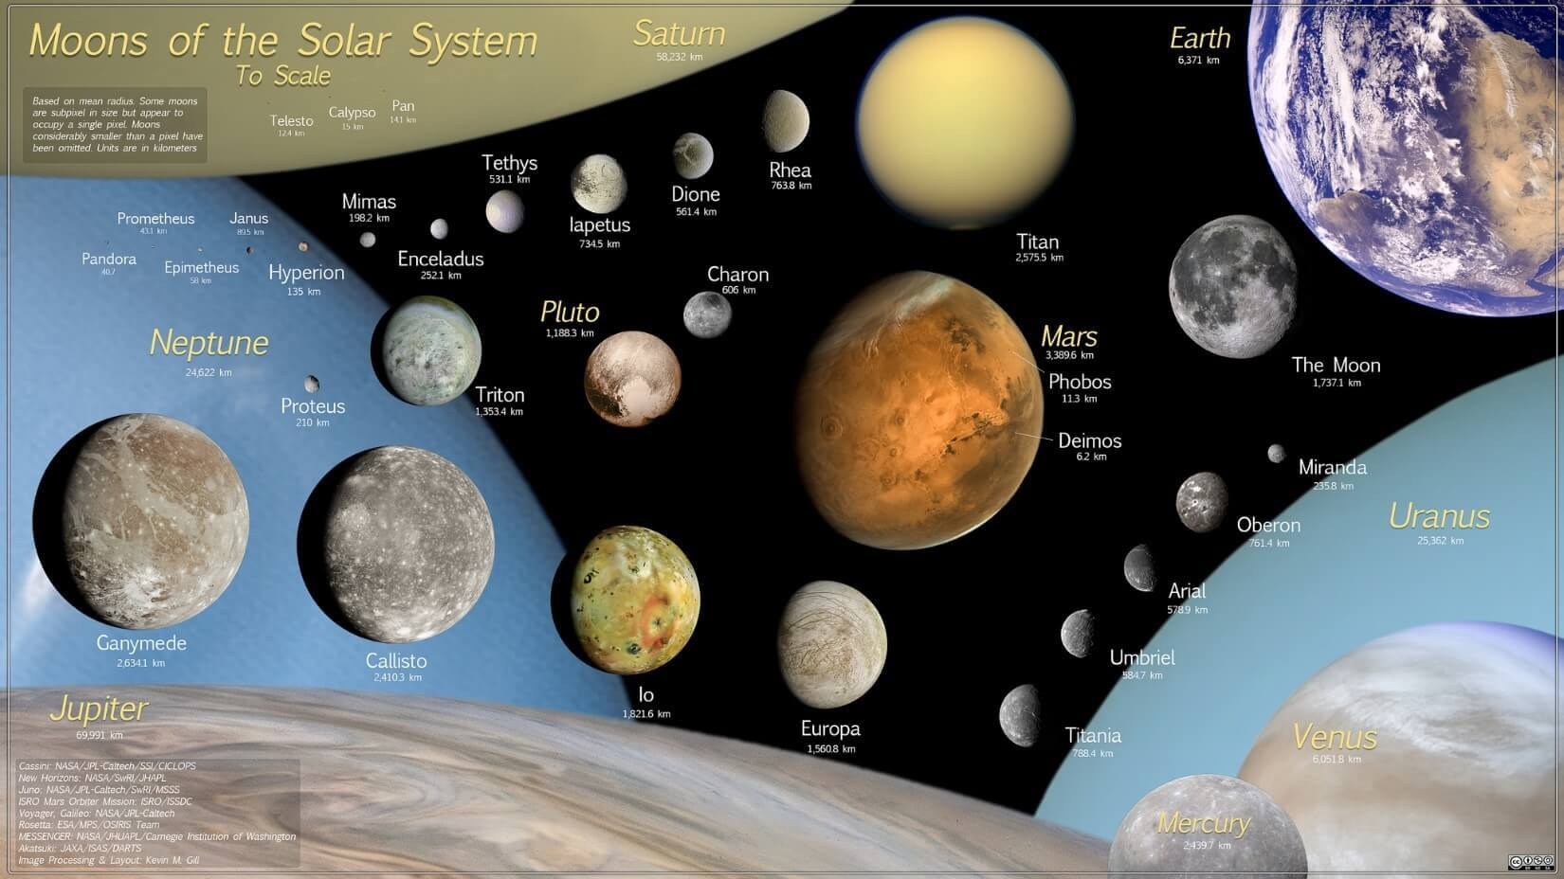
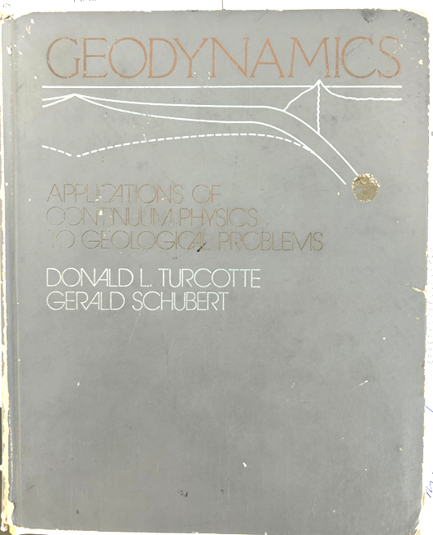
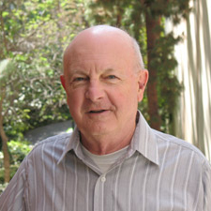
Closing Thoughts
Jerry had a hand inventing the concept of planetary science
He taught me how to be an interdisciplinary scientist
He was a great guy
Thanks Jerry

