Slide 1

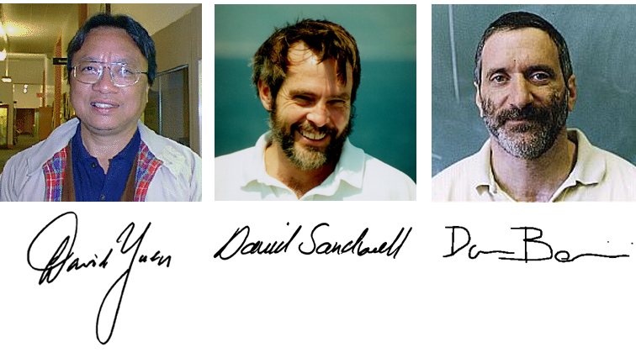
Jerry’s 70th Birthday

Slide 2
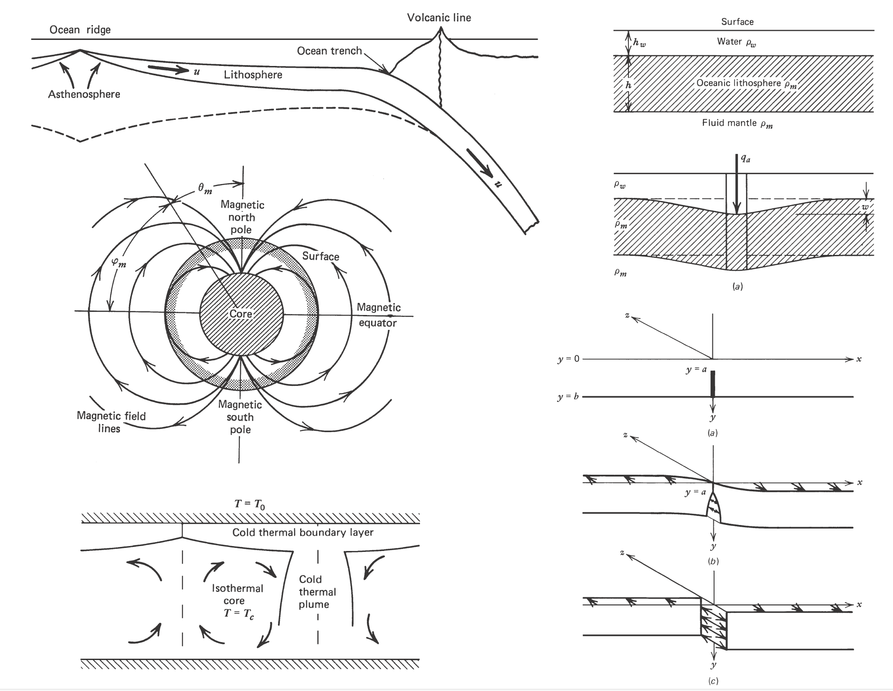
Geodynamics – Turcotte and Schubert
cited by 11096
1 Plate Tectonics
2 Stress and Strain in Solids
3 Elasticity and Flexure
4 Heat Transfer
5 Gravity
6 Fluid Mechanics
7 Rock Rheology
8 Faulting
9 Flows in Porous Media
10 Chemical Geodynamics

Slide 3
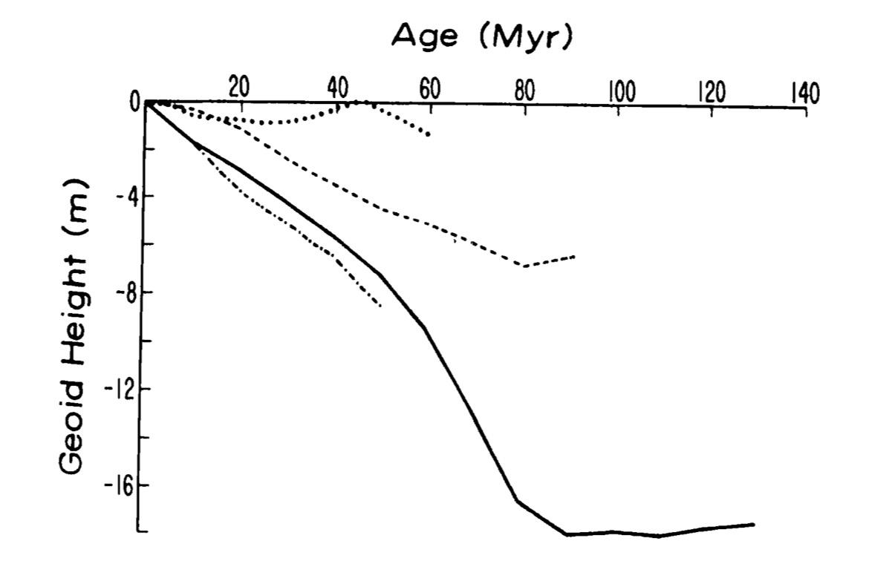
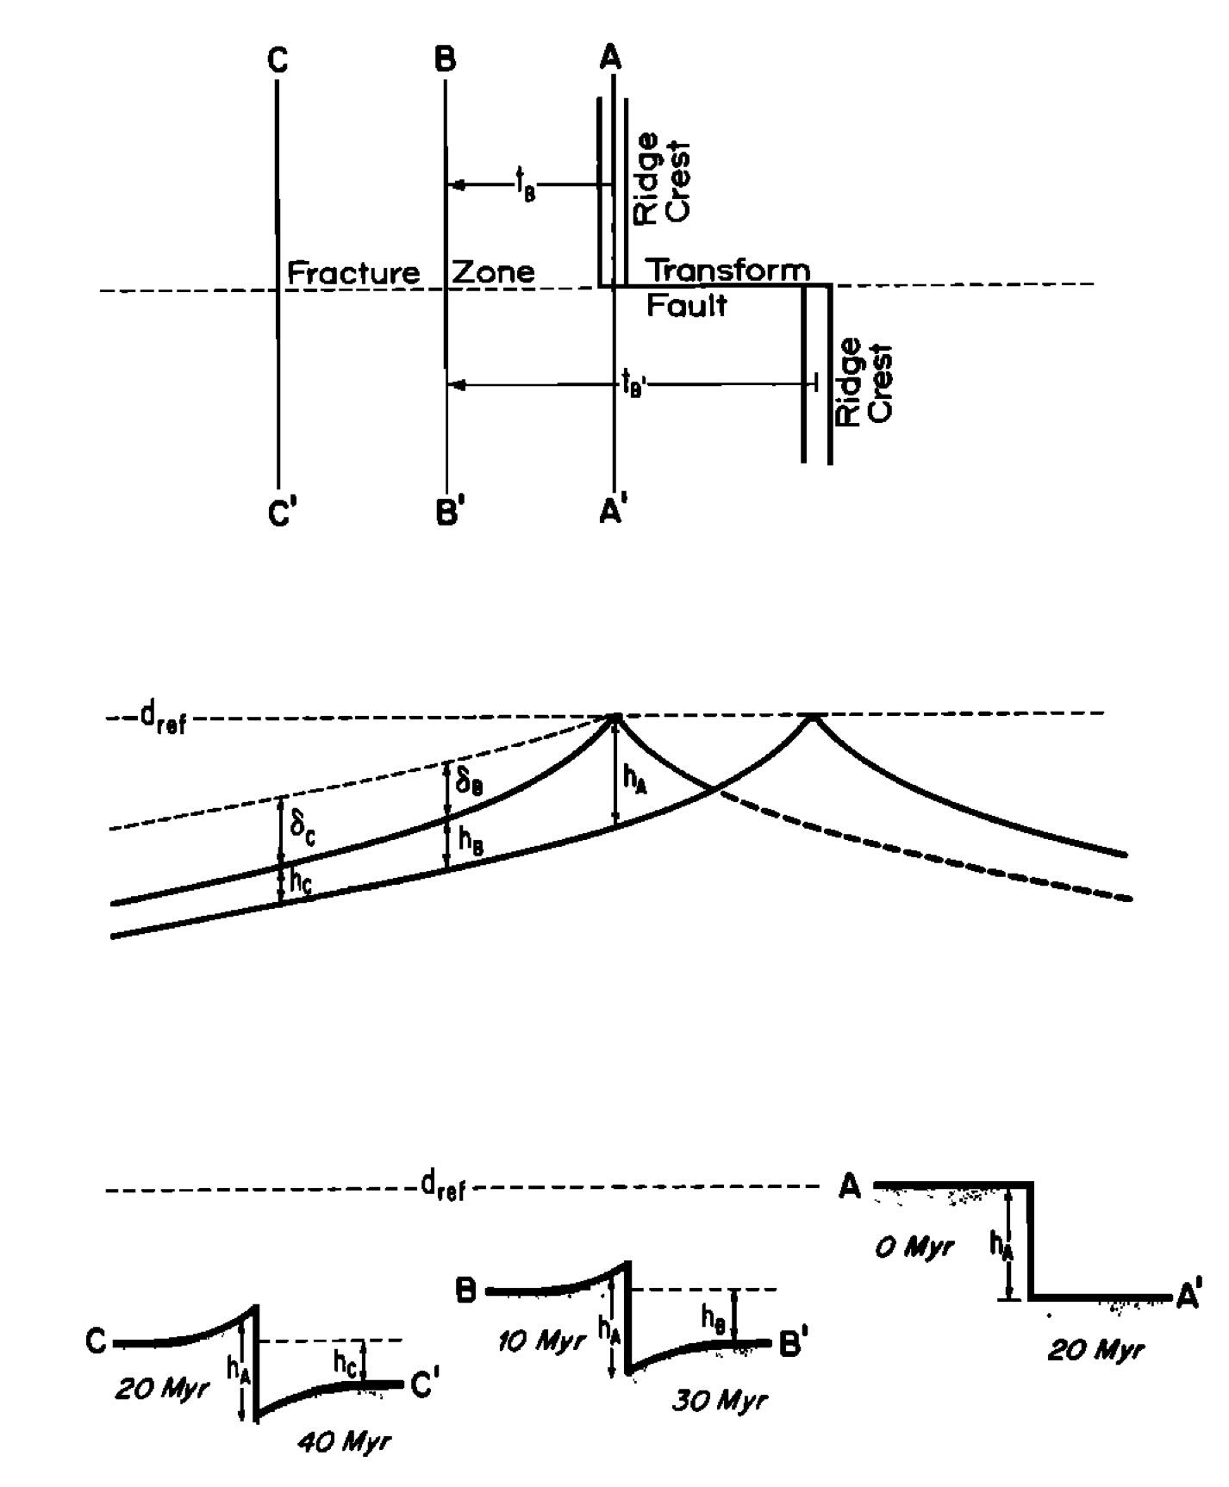
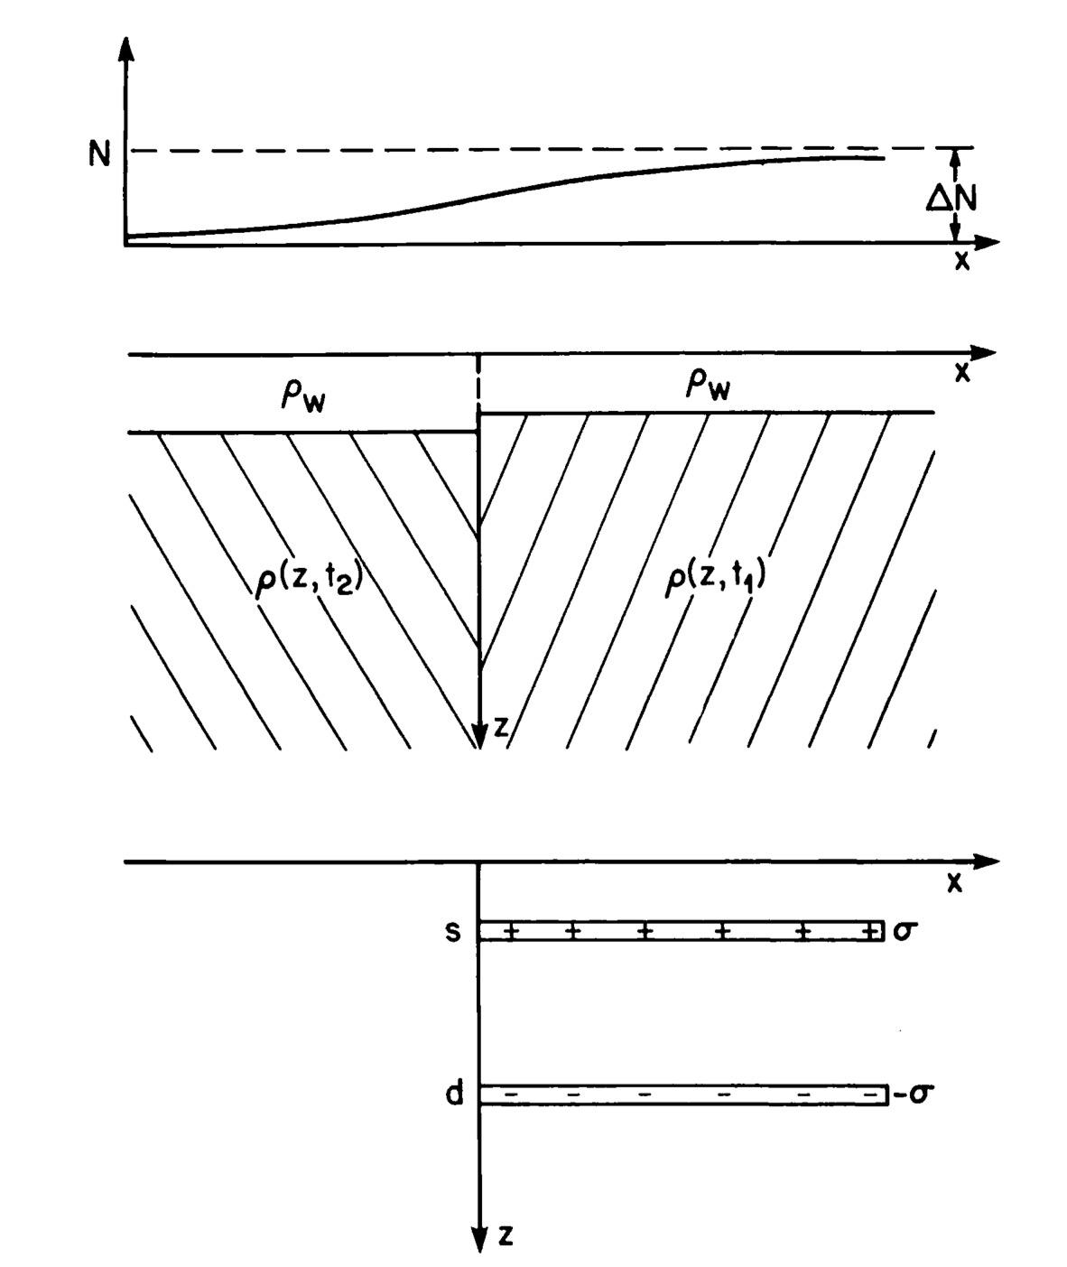
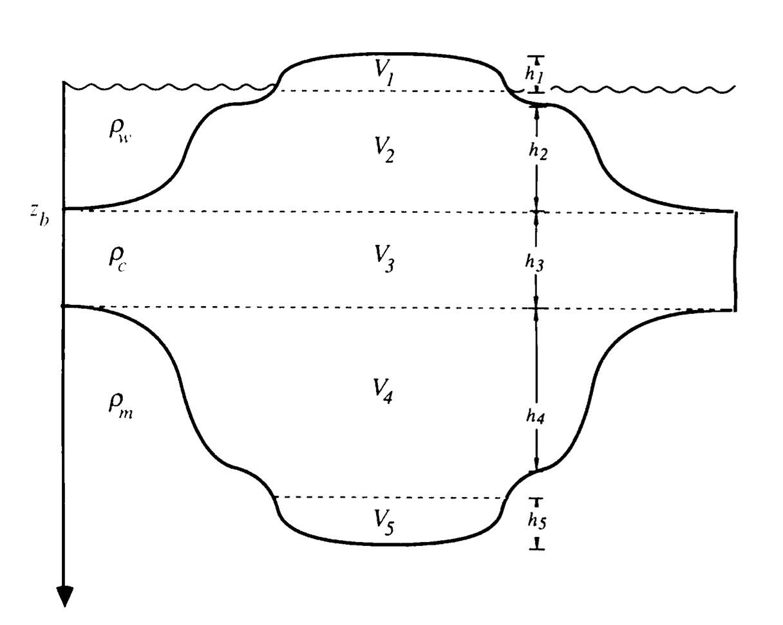
Earth

Slide 4
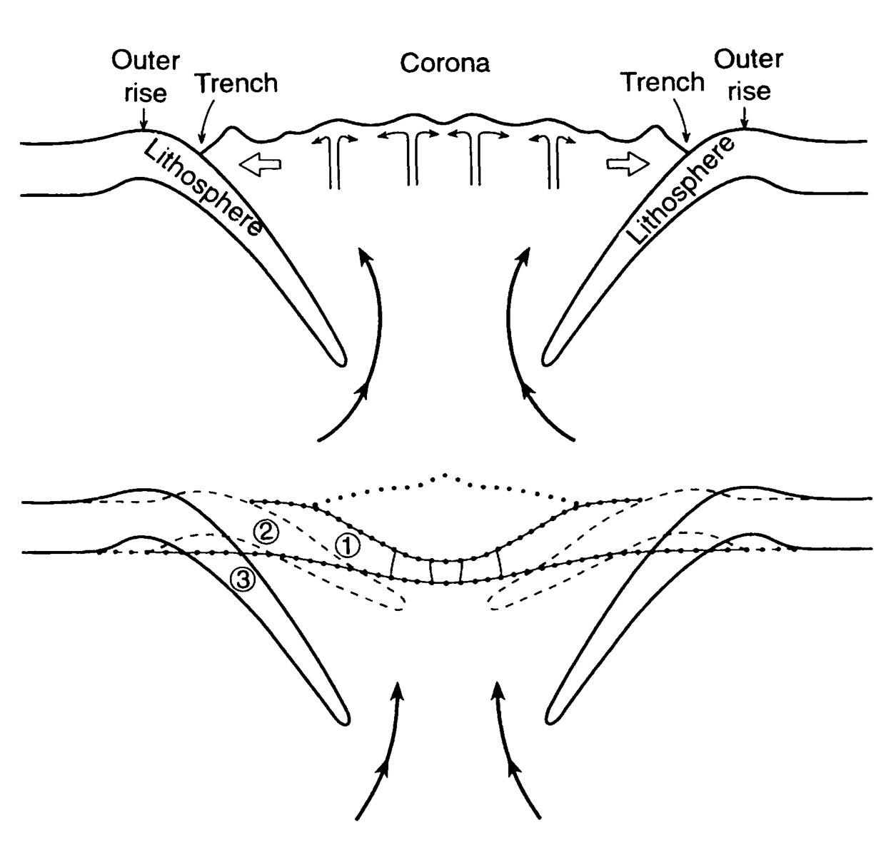
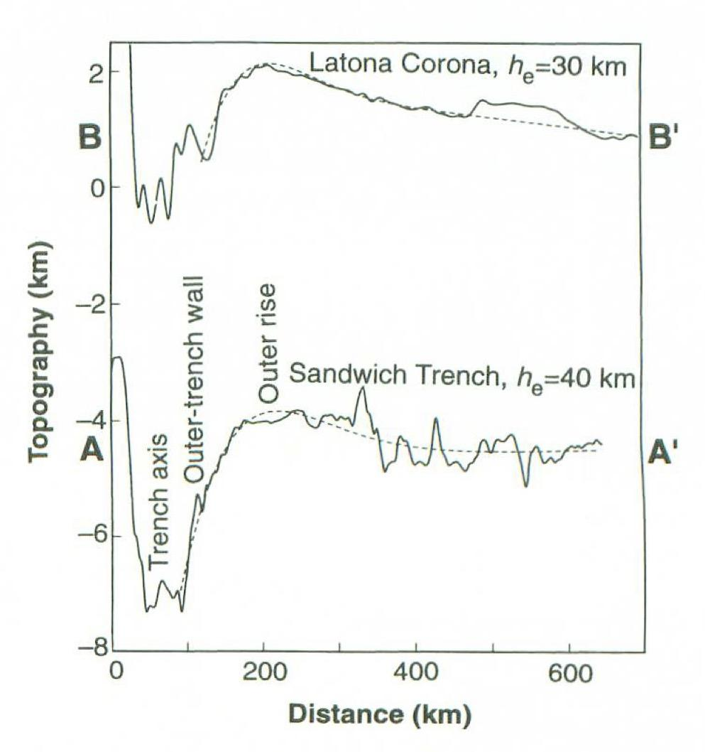
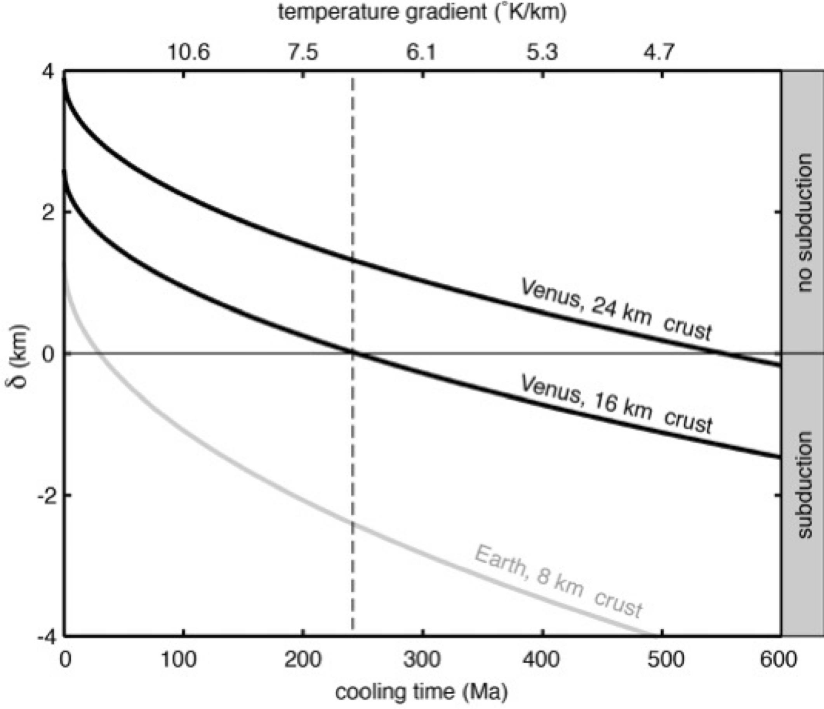
Venus Subduction?

Slide 5
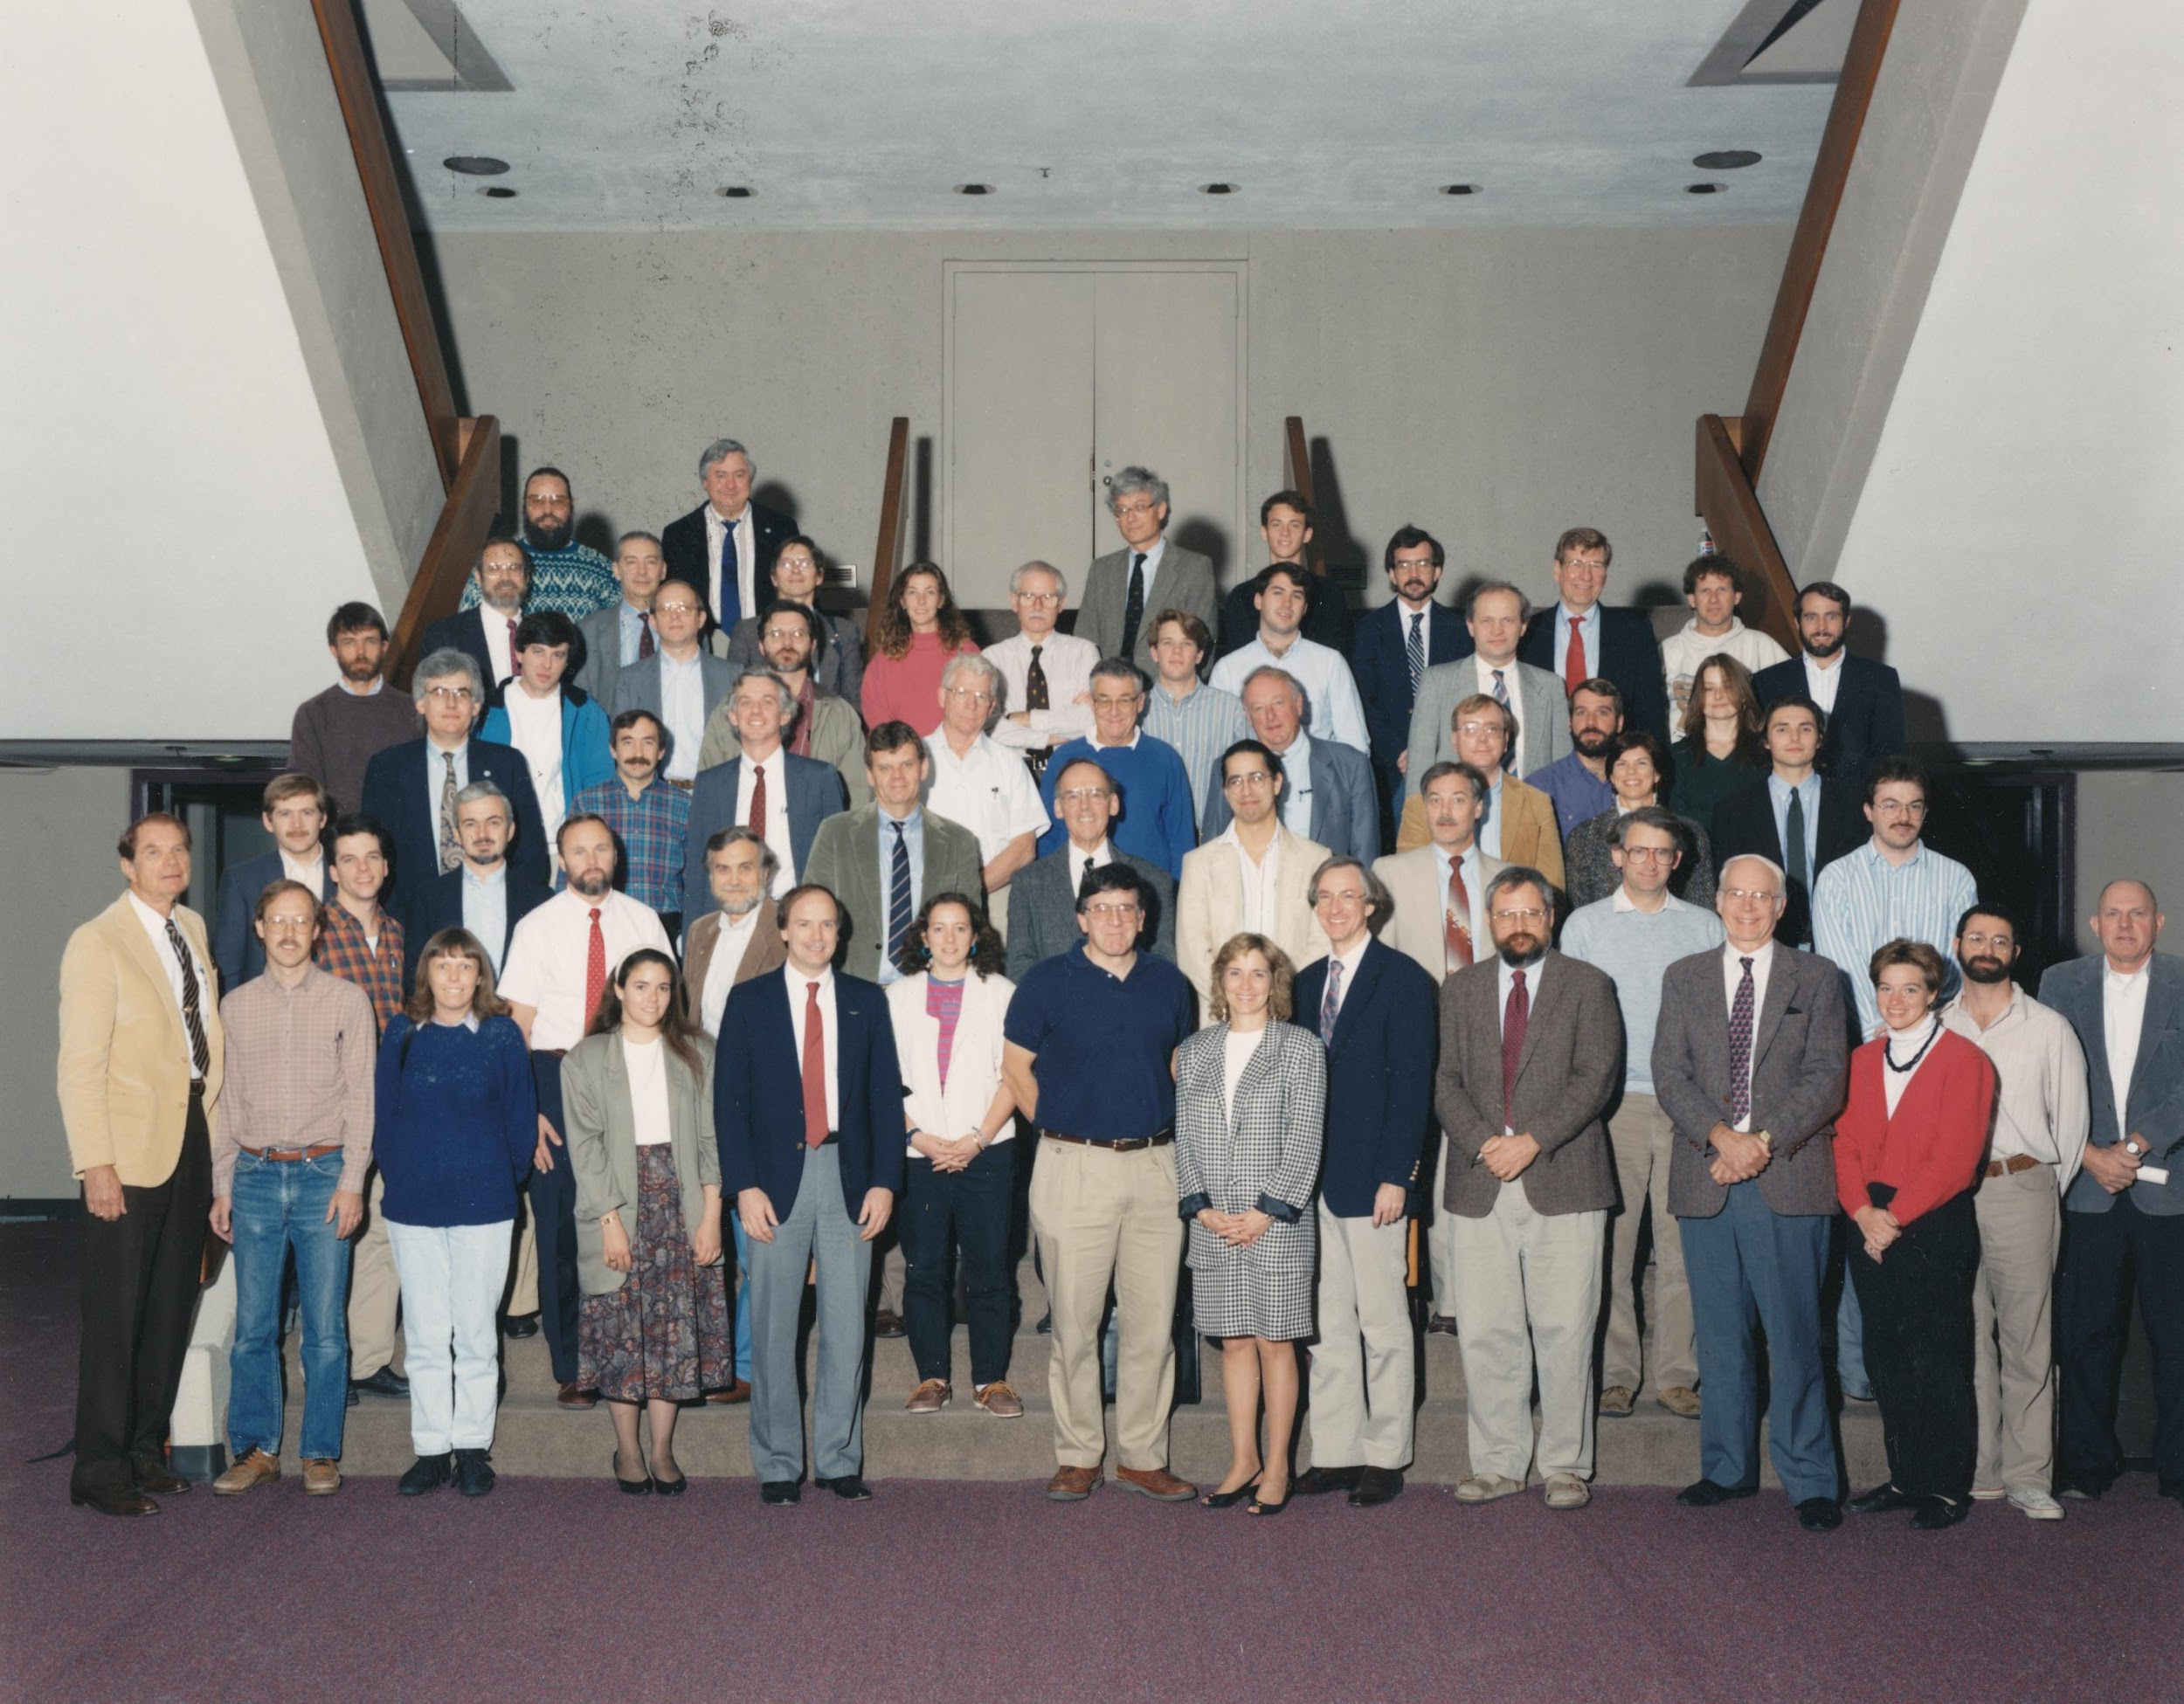
Magellan Science Team, 1991

Slide 6
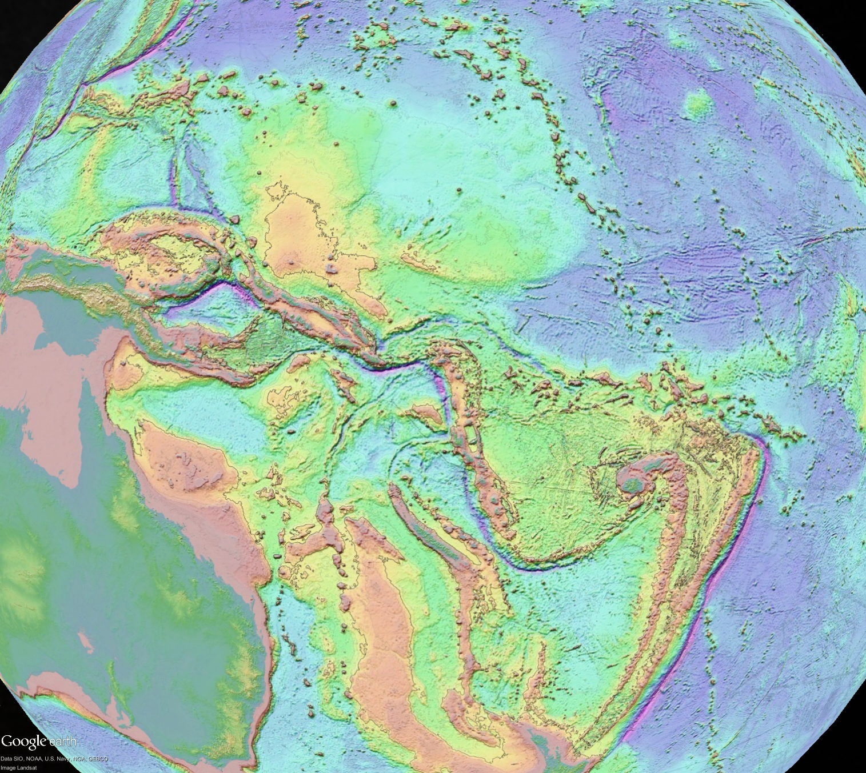
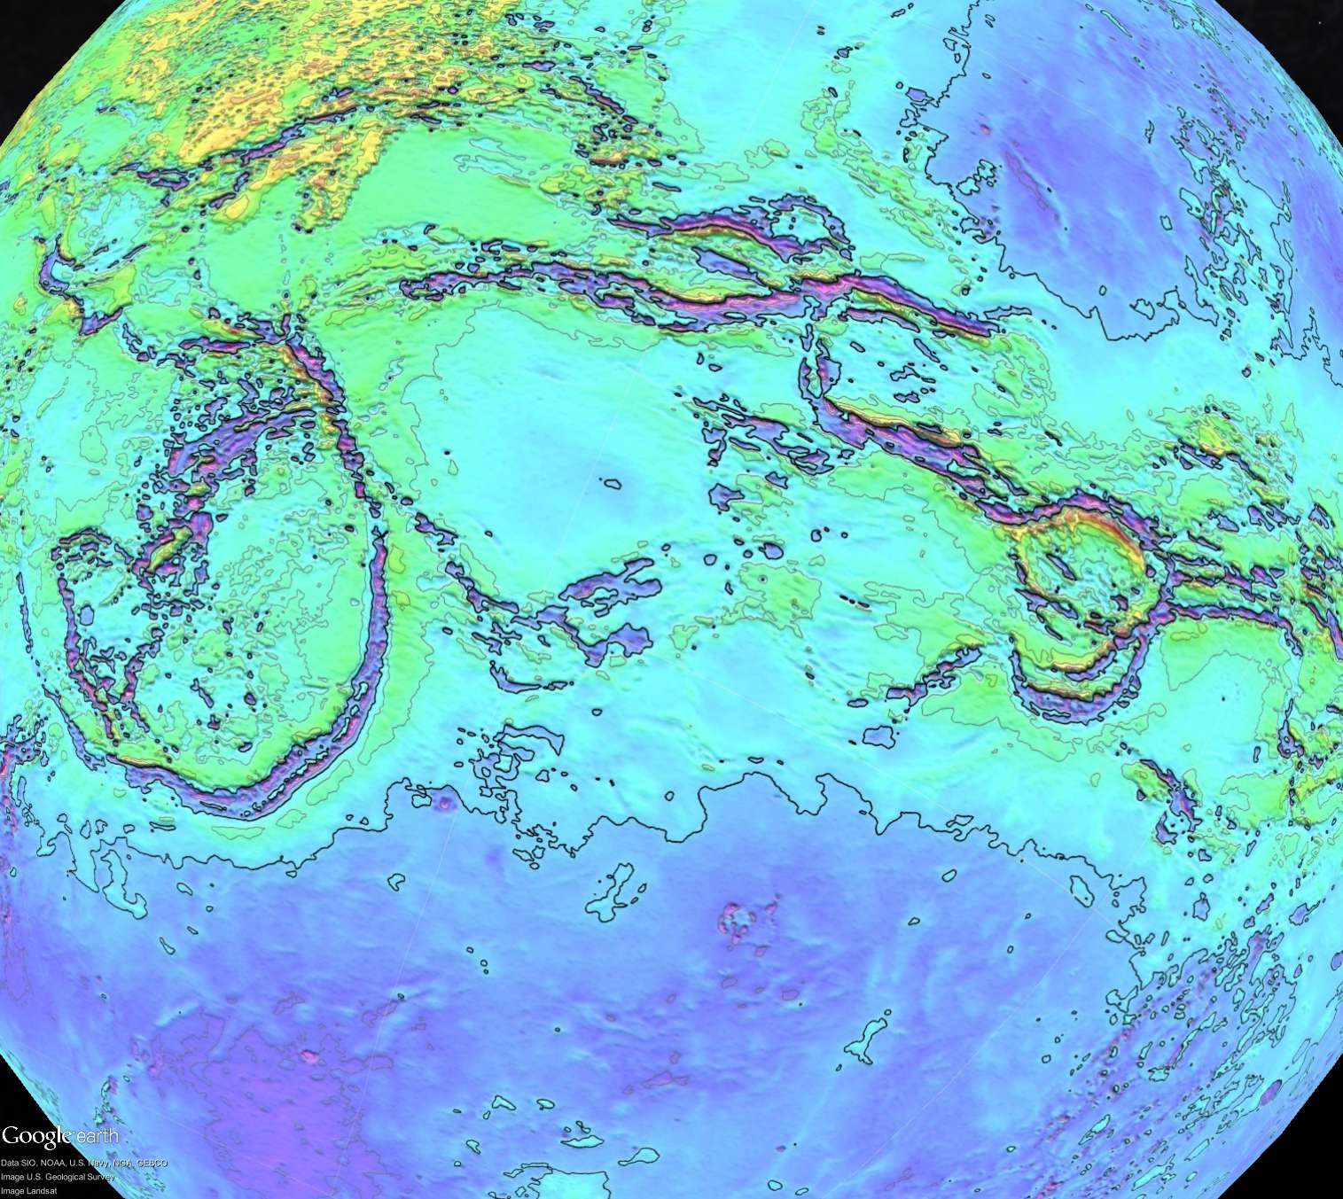
What additional information is needed to confirm or reject the subduction hypothesis?
Crustal thickness at in plains – buoyancy estimate
Seismology for possible Venus quakes – active plate boundaries?
InSAR for crustal deformation – active today?
High resolution topography – trench depth and outer rise fractures.
Gravity at < 200 km resolution – resolve flexurally-compensated features
InSAR correlation – map active volcanic flows
Need a new mission(s) to Venus

