Slide 1
Some Examples of Gerald Schubert’s Contributions
-Dave Stevenson, Caltech
1. The Urey Number Problem
2. Galilean satellite structure
3. Thermal evolution of Terrestrial Planets
4. Mantle convection including a phase change

Slide 2
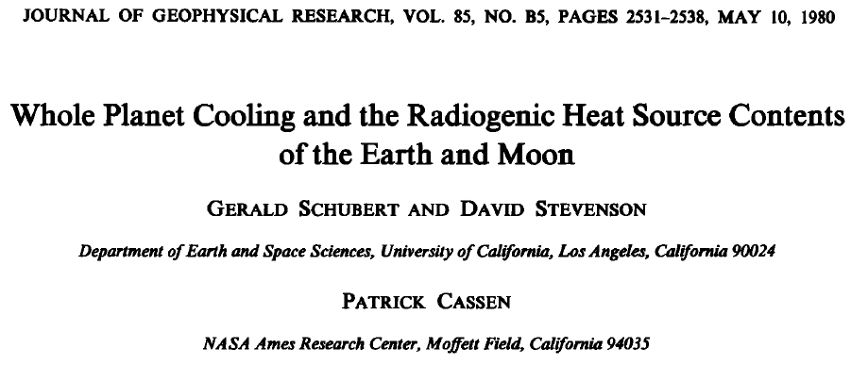
A genuine collaboration , with delayed publication because there were others doing the same problem.
An example of scientific squabbling over unimportant details.
But the problem is still not adequately solved!

Slide 3
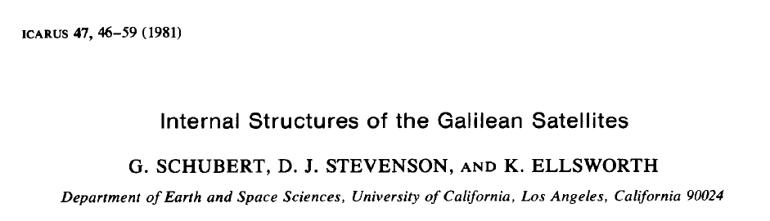
Motivated in part by our dissatisfaction with the highly publicized Io volcanism result (neither of us believed that you need a magma ocean but reviewers made us concede that it was at least possible).
Juno result (2025)- there is no magma ocean
Complete ice-rock separation still in doubt (Callisto, Titan, maybe not Ganymede?)

Slide 4
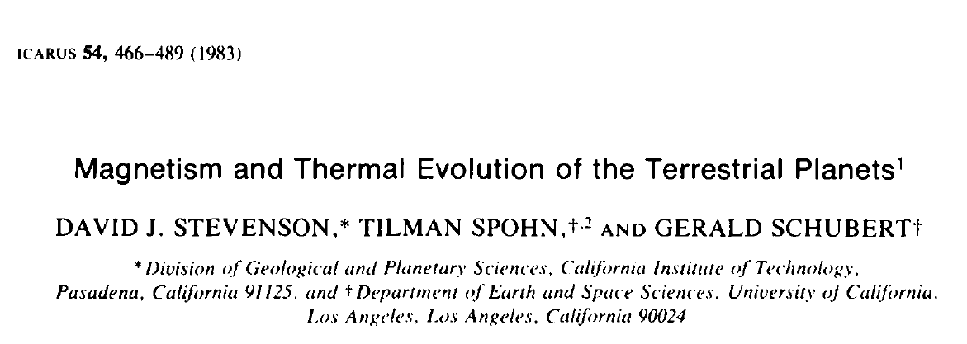
The calculations were entirely done at UCLA (punch cards!)
This paper would not have happened without the urging of Gerry! And the writing of Tilman.
We still debate the persistence or existence of dynamos in terrestrial plaents. Does Mars have an inner core(2025 paper)?

Slide 5
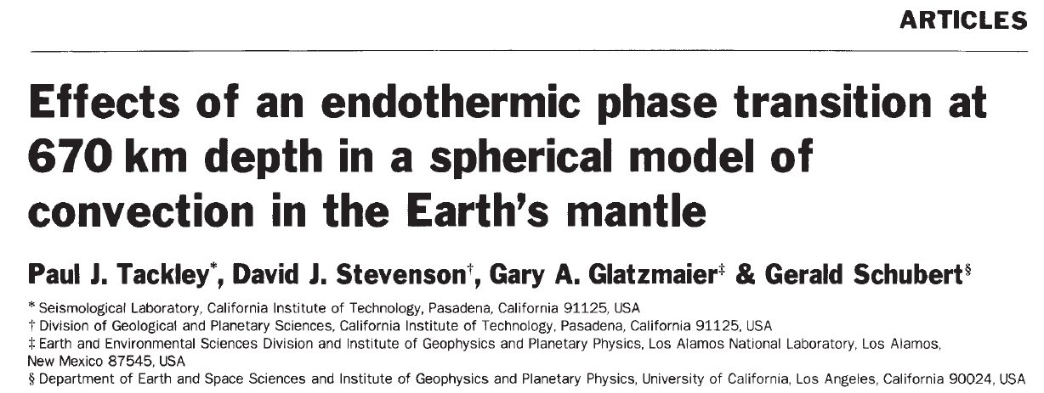
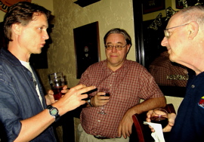
Nature in 1993 (we got the cover!)
Current views of 670km (make that 650?) are different
Paul parallelized Gary Glatzmaier’s code (a herculean effort) and enlisted Gerry’s expertise on including good thermodynamics and a phase transition.

